Slide 1

SUBJECT : EMBEDDED SYSTEMS
UNIT – IV
REAL-TIME OPERATING SYSTEM

Slide 2
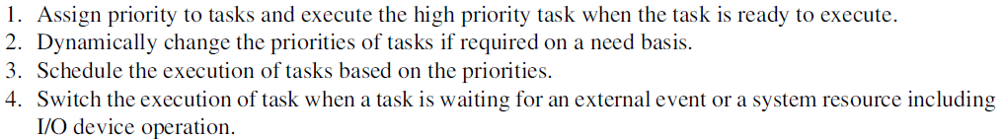
NEED FOR RTOS

Slide 3
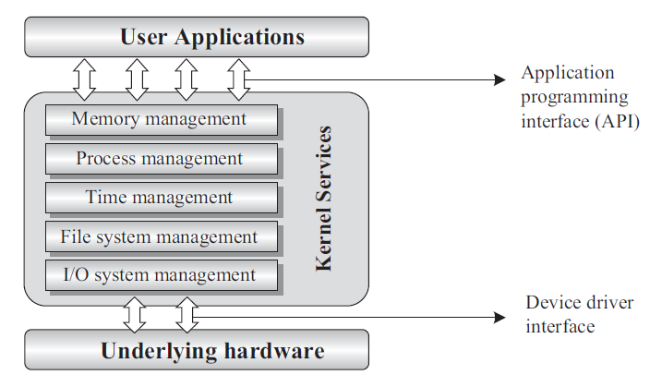
OPERATING SYSTEMS BASICS

Slide 4
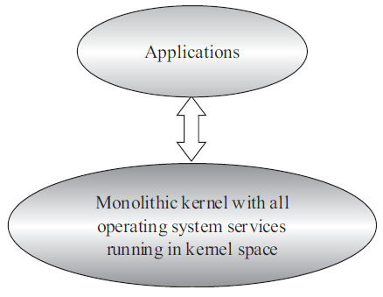
MONOLITHIC KERNEL

Slide 5
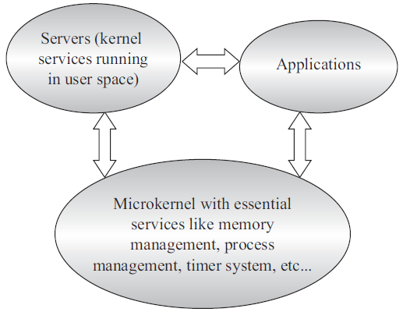
MICRO KERNEL

Slide 6
TYPES OF OPERATING SYSTEMS
Based on the responsiveness to the applications, the operating systems are classified as:
General Purpose OS
Real-time OS

Slide 7
TYPES OF OPERATING SYSTEMS - GPOS
The operating systems, which are deployed in general computing systems, are referred as General Purpose Operating Systems ( GPOS).
The kernel of such an OS is more generalized and it contains all kinds of services required for executing generic applications.
General-purpose operating systems are often quite non-deterministic in behavior. Their services can inject random delays into application software and may cause slow responsiveness of an application at unexpected times.
GPOS are usually deployed in computing systems where deterministic behavior is not an important criterion. Personal Computer/Desktop system is a typical example for a system where GPOSs are deployed.
Windows 10/8.x/XP/MS-DOS etc are examples for General Purpose Operating Systems.

Slide 8
TYPES OF OPERATING SYSTEMS - RTOS
Real-Time implies deterministic timing behaviour. Deterministic timing behaviour in RTOS context means the OS services consumes only known and expected amounts of time regardless the number of services.
Real-time kernel
Task/Process management
Task/Process scheduling
Task/Process synchronisation
Error/Exception handling
Memory management
Interrupt handling
Time management

Slide 9
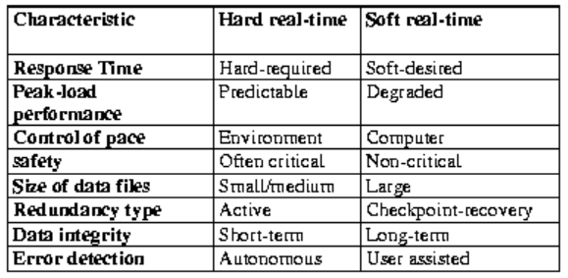
HARD REAL TIME vs. SOFT REAL TIME SYSTEMS

Slide 10
PROCESS
A ‘Process’ is a program, or part of it, in execution. Process is also known as an instance of a program in execution.
Multiple instances of the same program can execute simultaneously.
A process requires various system resources like CPU for executing the process, memory for storing the code corresponding to the process and associated variables, I/O devices for information exchange, etc.
A process is sequential in execution.

Slide 11
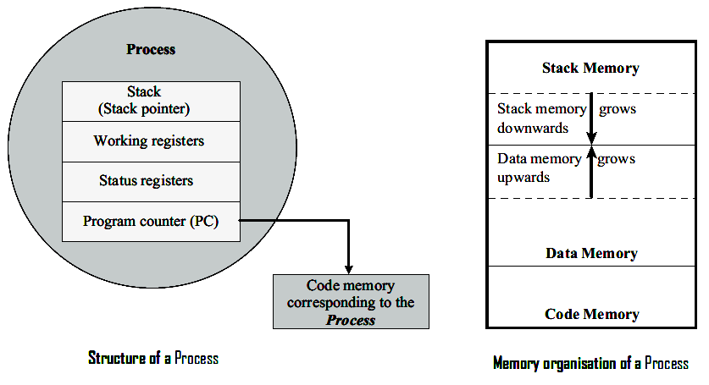
PROCESS

Slide 12
PROCESS
The creation of a process to its termination is not a single step operation. The process traverses through a series of states during its transition from the newly created state to the terminated state.
The cycle through which a process changes its state from ‘newly created’ to ‘execution completed’ is known as ‘ Process Life Cycle’.
The various states through which a process traverses through during a Process Life Cycle indicates the current status of the process with respect to time and also provides information on what it is allowed to do next.

Slide 13
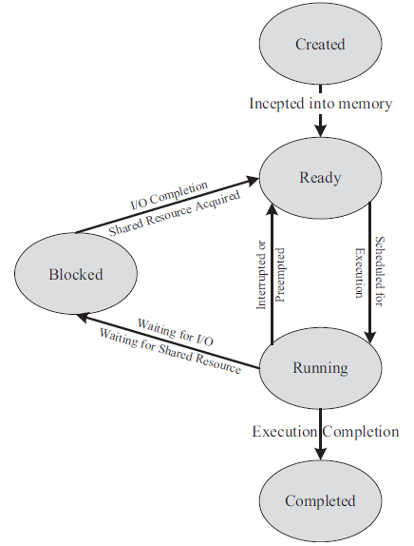
PROCESS LIFE CYCLE

Slide 14
PROCESS LIFE CYCLE
The state at which a process is being created is referred as ‘Created State’. The Operating System recognizes a process in the ‘Created State’ but no resources are allocated to the process.
The state, where a process is incepted into the memory and awaiting the processor time for execution, is known as ‘Ready State’. At this stage, the process is placed in the ‘Ready list’ queue maintained by the OS.
The state where in the source code instructions corresponding to the process is being executed is called ‘Running State’. Running state is the state at which the process execution happens.

Slide 15
PROCESS LIFE CYCLE
Blocked State/Wait State refers to a state where a running process is temporarily suspended from execution and does not have immediate access to resources. The blocked state might be invoked by various conditions like: the process enters a wait state for an event to occur (e.g. Waiting for user inputs such as keyboard input) or waiting for getting access to a shared).
A state where the process completes its execution is known as ‘Completed State’. The transition of a process from one state to another is known as ‘State transition’. When a process changes its state from Ready to running or from running to blocked or terminated or from blocked to running, the CPU allocation for the process may also change.

Slide 16
PROCESS MANAGEMENT
Process management deals with the creation of a process, setting up the memory space for the process, loading the process’s code into the memory space, allocating system resources, setting up a Process Control Block (PCB) for the process and process termination/deletion.

Slide 17
THREADS
A thread is the primitive that can execute code. A thread is a single sequential flow of control within a process. ‘Thread’ is also known as lightweight process.
A process can have many threads of execution. Different threads, which are part of a process, share the same address space; meaning they share the data memory, code memory and heap memory area.
Threads maintain their own thread status (CPU register values), Program Counter (PC) and stack.

Slide 18
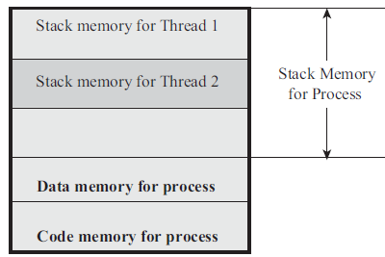
PROCESS MEMORY AND ASSOCIATED THREADS

Slide 19
CONCEPT OF MULTITHREADING
A process/task in embedded application may be a complex or lengthy one and it may contain various suboperations like getting input from I/O devices connected to the processor, performing some internal calculations/operations, updating some I/O devices etc.
If all the subfunctions of a task are executed in sequence, the CPU utilisation may not be effi cient. If the process is split into multiple threads, which executes a portion of the process, there will be a main thread and rest of the threads will be created within the main thread.

Slide 20
CONCEPT OF MULTITHREADING
Use of multiple threads to execute a process brings the following advantage.
Better memory utilization. Multiple threads of the same process share the address space for data memory. This also reduces the complexity of inter thread communication since variables can be shared across the threads.
Since the process is split into different threads, when one thread enters a wait state, the CPU can be utilized by other threads of the process that do not require the event, which the other thread is waiting, for processing. This speeds up the execution of the process.
Efficient CPU utilization. The CPU is engaged all time.

Slide 21
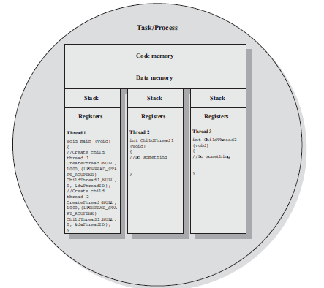
A PROCESS WITH MULTITHREAD

Slide 22
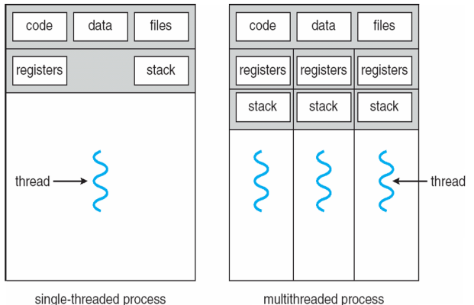
SINGLE-THREADED AND MULTITHREADED PROCESS

Slide 23
THREADS
Thread library provides programmer with API for creating and managing threads.
Two primary ways of implementing
library entirely in user space with no kernel support
kernel-level library supported by the OS
There are three standard libraries for threads.
POSIX
WIN32
JAVA

Slide 24
THREADS - PTHREAD
A POSIX standard API for thread creation and synchronization • common in UNIX operating systems (Solaris, Linux, Mac OS X).
Pthread is a specification for thread behavior implementation is up to developer of the library
e.g., Pthreads may be provided either as user-level or kernel-level

Slide 25
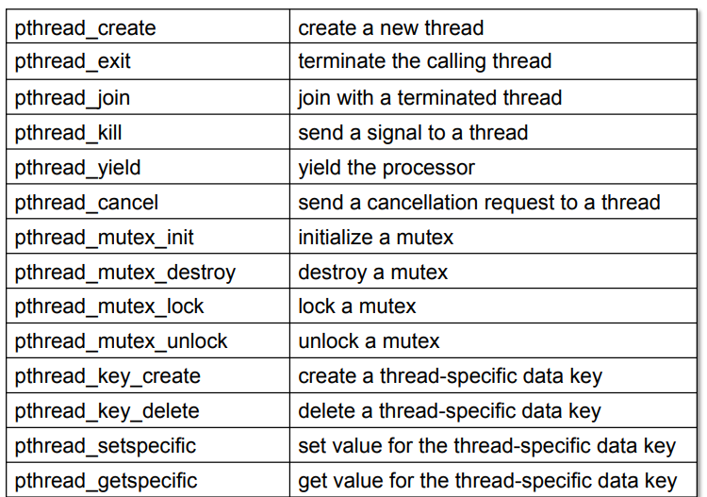
THREADS – PTHREAD APIs

Slide 26
THREADS – WIN32 THREAD
Win32 threads are the threads supported by various flavors of Windows Operating Systems.
The Win32 Application Programming Interface (Win32 API) libraries provide the standard set of Win32 thread creation and management functions.

Slide 27
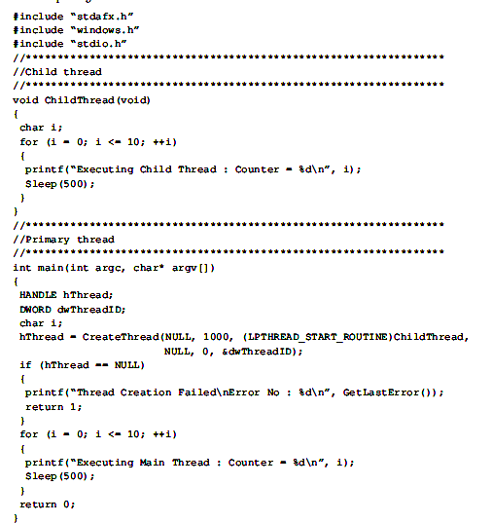
EXAMPLE

Slide 28
THREADS – JAVA THREAD
Java threads are managed by the Java VM
implemented using the threads model provided by underlying OS.
Java threads may be created by:
extending the java.lang.Thread class
then implement the java.lang.Runnable interface

Slide 29
THREAD PRE-EMPTION
Thread pre-emption is the act of pre-empting the currently running thread (stopping the currently running thread temporarily).
Thread pre-emption ability is solely dependent on the Operating System. Thread pre-emption is performed for sharing the CPU time among all the threads. The execution switching among threads are known as ‘Thread context switching’. Thread context switching is dependent on the Operating system’s scheduler and the type of the thread.

Slide 30
TYPES OF THREADS
Thread may be provided either at the user level, or by the kernel
user threads are supported above the kernel without kernel support
three thread libraries:
POSIX Pthreads,
Win32 threads
Java threads
kernel threads are supported and managed directly by the kernel
all contemporary OS supports kernel threads
Multithreading models: ways to map user threads to kernel threads
many-to-one model
one-to-one model
many-to-many model

Slide 31
MULTITHREADING MODELS – MANY-TO-ONE
Many user-level threads mapped to a single kernel thread
thread management is done by the thread library in user space (efficient)
entire process will block if a thread makes a blocking system call
convert blocking system call to non-blocking (e.g., select in Unix)
multiple threads are unable to run in parallel on multi-processors
Examples
Solaris green threads
GNU portable threads

Slide 32
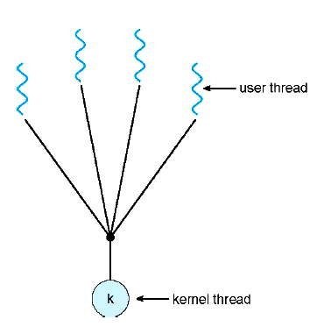
MULTITHREADING MODELS – MANY-TO-ONE

Slide 33
MULTITHREADING MODELS – ONE-TO-ONE
Each user-level thread maps to one kernel thread
it allows other threads to run when a thread blocks
multiple thread can run in parallel on multiprocessors
creating a user thread requires creating a corresponding kernel thread
it leads to overhead
most OSes implementing this model limit the number of threads
Examples
Windows NT/XP/2000
Linux
Solaris 9 and later

Slide 34
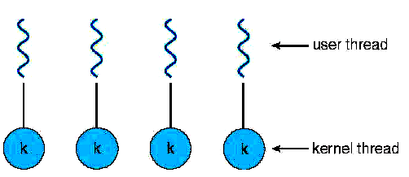
MULTITHREADING MODELS – ONE-TO-ONE

Slide 35
MULTITHREADING MODELS – MANY-TO-MANY
Many user level threads are mapped to many kernel threads
it solves the shortcomings of 1:1 and m:1 model
developers can create as many user threads as necessary
corresponding kernel threads can run in parallel on a multiprocessor
Examples
Solaris prior to version 9
Windows NT/2000 with the ThreadFiber package

Slide 36
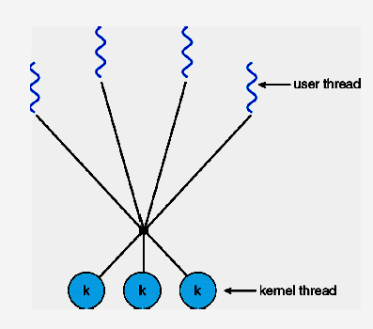
MULTITHREADING MODELS – MANY-TO-MANY

Slide 37
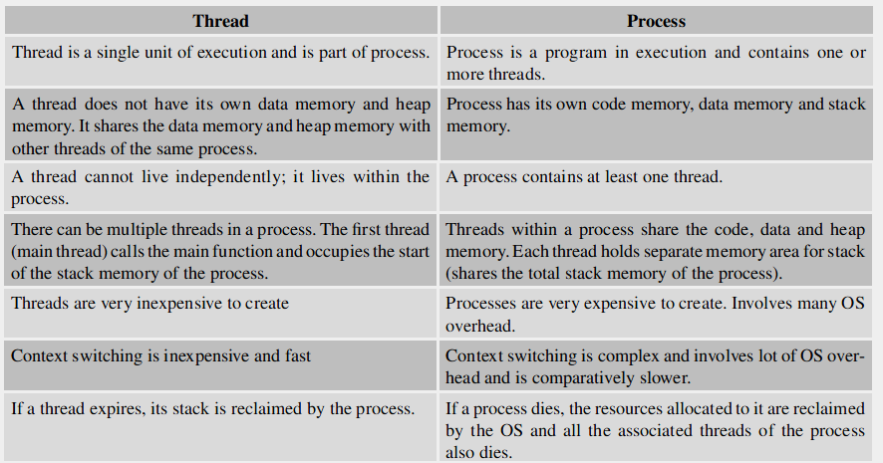
THREAD VS. PROCESS

Slide 38
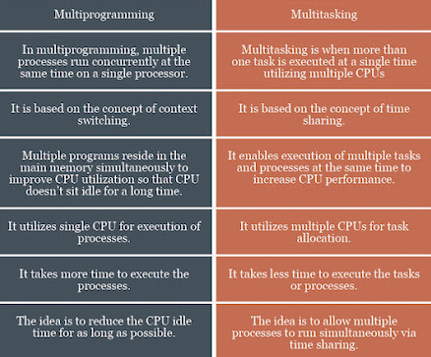
MULTIPROGRAMMING VS. MULTITASKING

Slide 39
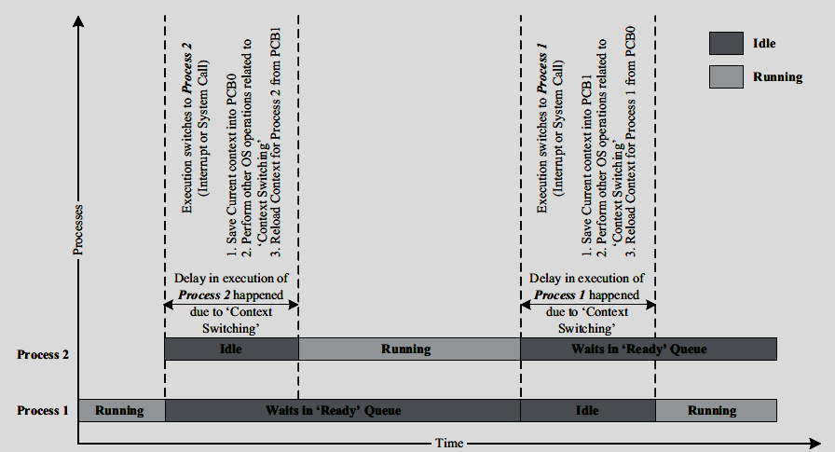
CONTEXT SWITCHING

Slide 40
TYPES OF MULTITASKING
Co-operative Multitasking
Co-operative multitasking is the most primitive form of multitasking in which a task/process gets a chance to execute only when the currently executing task/process voluntarily relinquishes the CPU.
In this method, any task/process can hold the CPU as much time as it wants. Since this type of implementation involves the mercy of the tasks each other for getting the CPU time for execution, it is known as co-operative multitasking.
If the currently executing task is non-cooperative, the other tasks may have to wait for a long time to get the CPU.

Slide 41
TYPES OF MULTITASKING
Preemptive Multitasking
Preemptive multitasking ensures that every task/process gets a chance to execute. Then and how much time a process gets is dependent on the implementation of the preemptive scheduling.
As the name indicates, in preemptive multitasking, the currently running task/process is preempted to give a chance to other tasks/process to execute.
The preemption of task may be based on time slots or task/process priority.

Slide 42
TYPES OF MULTITASKING
Non-preemptive Multitasking
In non-preemptive multitasking, the process/task, which is currently given the CPU time, is allowed to execute until it terminates (enters the ‘Completed’ state) or enters the ‘Blocked/Wait’ state, waiting for an I/O or system resource.

Slide 43
TYPES OF MULTITASKING
In co-operative multitasking, the currently executing process/task need not relinquish the CPU when it enters the ‘Blocked/Wait’ state, waiting for an I/O, or a shared resource access or an event to occur whereas in non-preemptive multitasking the currently executing task relinquishes the CPU when it waits for an I/O or system resource or an event to occur.

Slide 44
SCHEDULING
There should be some mechanism in place to share the CPU among the different tasks and to decide which process/task is to be executed at a given point of time. Determining which task/process is to be executed at a given point of time is known as task/process scheduling.
Task scheduling forms the basis of multitasking. Scheduling policies forms the guidelines for determining which task is to be executed when.
The scheduling policies are implemented in an algorithm and it is run by the kernel as a service. The kernel service/application, which implements the scheduling algorithm, is known as ‘Scheduler’. The process scheduling decision may take place when a process switches its state to
‘Ready’ state from ‘Running’ state
’Blocked/Wait’ state from ‘Running’ state
‘Ready’ state from ‘Blocked/Wait’ state
‘Completed’ state

Slide 45
FACTORS TO BE CONSIDERED WHILE IMPLEMENTING SCHEDULING ALGORITHMS
CPU Utilization: The scheduling algorithm should always make the CPU utilization high. CPU utilization is a direct measure of how much percentage of the CPU is being utilized.
Throughput: This gives an indication of the number of processes executed per unit of time. The throughput for a good scheduler should always be higher.
Turnaround Time: It is the amount of time taken by a process for completing its execution. It includes the time spent by the process for waiting for the main memory, time spent in the ready queue, time spent on completing the I/O operations, and the time spent in execution. The turnaround time should be a minimal for a good scheduling algorithm.

Slide 46
FACTORS TO BE CONSIDERED WHILE IMPLEMENTING SCHEDULING ALGORITHMS
Waiting Time: It is the amount of time spent by a process in the ‘Ready’ queue waiting to get the CPU time for execution. The waiting time should be minimal for a good scheduling algorithm.
Response Time: It is the time elapsed between the submission of a process and the first response. For a good scheduling algorithm, the response time should be as least as possible.

Slide 47
QUEUES USED BY OS DURING SCHEDULING
The various queues maintained by OS in association with CPU scheduling are:
Job Queue: Job queue contains all the processes in the system.
Ready Queue: Contains all the processes, which are ready for execution and waiting for CPU to get their turn for execution. The Ready queue is empty when there is no process ready for running.
Device Queue: Contains the set of processes, which are waiting for an I/O device.

Slide 48
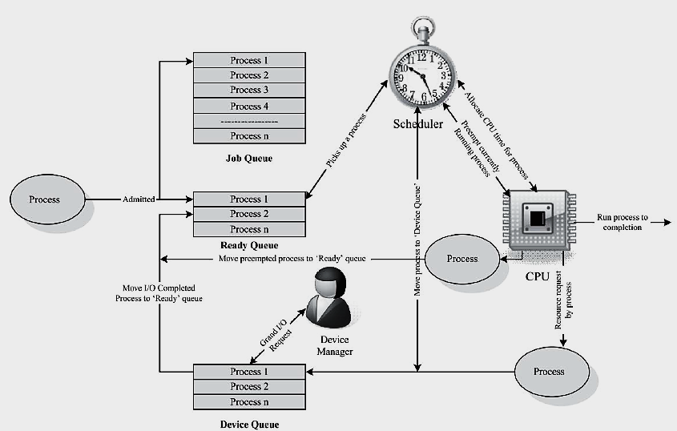
PROCESS TRANSITION THROUGH VARIOUS QUEUES

Slide 49
NON-PREEMPTIVE SCHEDULING
Non-preemptive scheduling is employed in systems, which implement non-preemptive multitasking model.
In this scheduling type, the currently executing task/process is allowed to run until it terminates or enters the ‘Wait’ state waiting for an I/O or system resource. The various types of non-preemptive scheduling adopted in task/process scheduling are:
FIFO
LCFS/LIFO
SHORTEST JOB FIRST (SJF)
PRIORITY BASED SCHEDULING

Slide 50
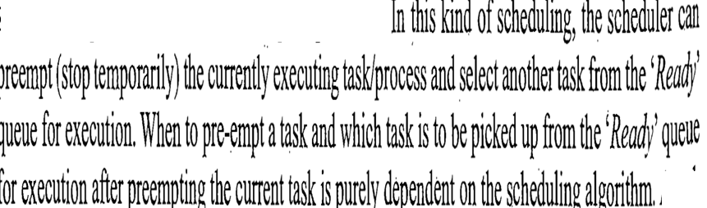
PREEMPTIVE SCHEDULING

Slide 51
TASK COMMUNICATION
In a multitasking system, multiple tasks/processes run concurrently parallelism) and each process may or may not interact between. Based on the degree of interaction, the processes running on an OS are classified as
Co-operating Processes: In the co-operating interaction model one process requires the inputs from other processes to complete its execution.
Competing Processes: The competing processes do not share anything among themselves but they share the system resources. The competing processes compete for the system resources such as fi le, display device, etc. Co-operating processes exchanges information and communicate through the following methods.
Co-operation through Sharing: The co-operating process exchange data through some shared resources.
Co-operation through Communication: No data is shared between the processes. But they communicate for synchronization.
The mechanism through which processes/tasks communicate each other is known as Inter Process/Task Communication (IPC). Inter Process Communication is essential for process co-ordination

Slide 52

TASK COMMUNICATION
Shared Memory
Processes share some area of the memory to communicate among them.
Information to be communicated by the process is written to the shared memory area. Other processes which require this information can read the same from the shared memory area. The implementation of shared memory concept is kernel dependent. Different mechanisms are adopted by different kernels for implementing this.

Slide 53
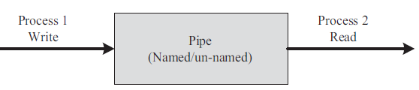
TASK COMMUNICATION
Shared Memory: Pipe
Pipe is a section of the shared memory used by processes for communicating. Pipes follow the client-server architecture. A process which creates a pipe is known as a pipe server and a process which connects to a pipe is known as pipe client.
A pipe can be considered as a conduit for information flow and has two conceptual ends.
It can be unidirectional, allowing information flow in one direction or bidirectional allowing bi-directional information flow.
A unidirectional pipe allows the process connecting at one end of the pipe to write to the pipe and the process connected at the other end of the pipe to read the data.
A bi-directional pipe allows both reading and writing at one end.

Slide 54
TASK COMMUNICATION
Shared Memory: Pipe
The implementation of ‘Pipes’ is also OS dependent. Windows support two types of ‘Pipes’ for Inter Process Communication.
Anonymous Pipes: The anonymous pipes are unnamed, unidirectional pipes used for data transfer between two processes.
Named Pipes: Named pipe is a named, unidirectional or bi-directional pipe for data exchange between processes. Like anonymous pipes, the process which creates the named pipe is known as pipe server.
A process which connects to the named pipe is known as pipe client. With named pipes, any process can act as both client and server allowing point-to-point communication.
Named pipes can be used for communicating between processes running on the same machine or between processes running on different machines connected to a network.

Slide 55
TASK COMMUNICATION
Shared Memory: Memory Mapped Objects
Memory mapped object is a shared memory technique adopted by certain Real-Time Operating Systems for allocating a shared block of memory which can be accessed by multiple process simultaneously.
In this approach a mapping object is created and physical storage for it is reserved and committed.
A process can map the entire committed physical area or a block of it to its virtual address space.
All read and write operation to this virtual address space by a process is directed to its committed physical area.
Any process which wants to share data with other processes can map the physical memory area of the mapped object to its virtual memory space and use it for sharing the data.

Slide 56
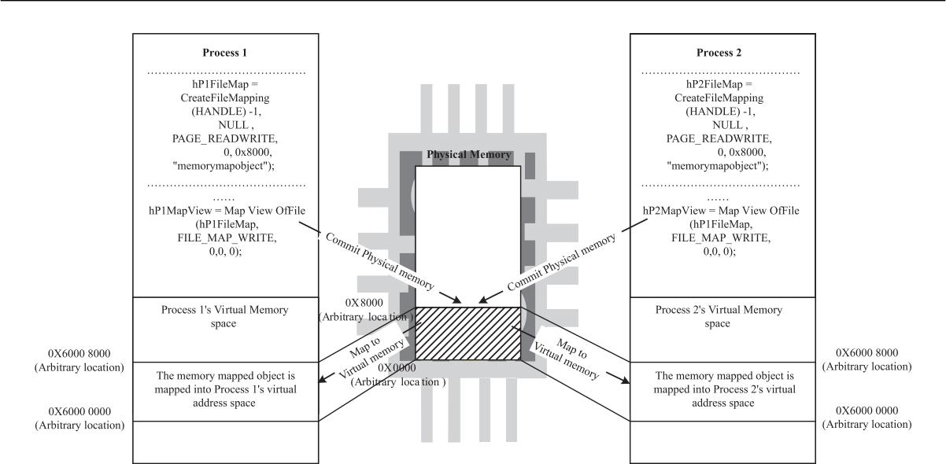
TASK COMMUNICATION
Shared Memory: Memory Mapped Objects

Slide 57
TASK COMMUNICATION
Message Passing
Message passing is an (a)synchronous information exchange mechanism used for Inter Process/Thread Communication.
The major difference between shared memory and message passing technique is that, through shared memory lots of data can be shared whereas only limited amount of info/data is passed through message passing.
Also message passing is relatively fast and free from the synchronization overheads compared to shared memory.

Slide 58
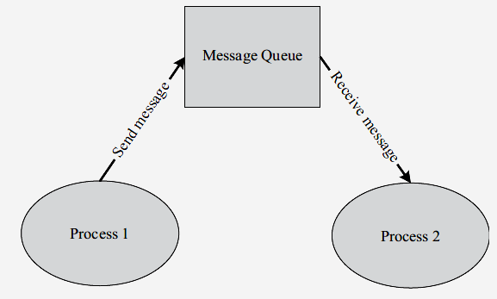
TASK COMMUNICATION
Message Passing: Message Queue
Usually the process which wants to talk to another process posts the message to a First-In-First-Out (FIFO) queue called ‘Message queue’, which stores the messages temporarily in a system defined memory object, to pass it to the desired process Messages are sent and received through send (Name of the process to which the message is to be sent, message) and receive (Name of the process from which the message is to be received, message) methods. The messages are exchanged through a message queue. The implementation of the message queue, send and receive methods are OS kernel dependent.

Slide 59
TASK COMMUNICATION
Message Passing: Mail Box
Mailbox is an alternate form of ‘Message queues’ and it is used in certain Real-Time Operating Systems for IPC. Mailbox technique for IPC in RTOS is usually used for one way messaging.
The task/thread which wants to send a message to other tasks/threads creates a mailbox for posting the messages.
The threads which are interested in receiving the messages posted to the mailbox by the mailbox creator thread can subscribe to the mailbox. The thread which creates the mailbox is known as ‘mailbox server’ and the threads which subscribe to the mailbox are known as ‘mailbox clients’. The mailbox server posts messages to the mailbox and notifies it to the clients which are subscribed to the mailbox.
The clients read the message from the mailbox on receiving the notification. The mailbox creation, subscription, message reading and writing are achieved through OS kernel provided API calls. Mailbox and message queues are same in functionality.
The only difference is in the number of messages supported by them. Both of them are used for passing data in the form of message(s) from a task to another task(s). Mailbox is used for exchanging a single message between two tasks or between an Interrupt Service Routine (ISR) and a task

Slide 60
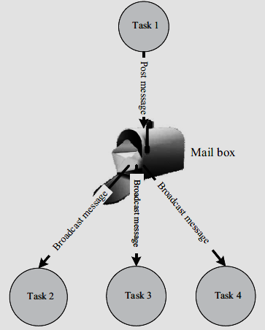
TASK COMMUNICATION
Message Passing: mail box

Slide 61
TASK COMMUNICATION
Message Passing: Signaling
Signaling is a primitive way of communication between processes/threads. Signals are used for asynchronous notifications where one process/thread fi res a signal, indicating the occurrence of a scenario which the other process(es)/thread(s) is waiting.
Signals are not queued and they do not carry any data. The communication mechanisms used in RTX51 Tiny OS is an example for Signaling. The os_send_signal kernel call under RTX 51 sends a signal from one task to a specified task. Similarly the os_wait kernel call waits for a specified signal.

Slide 62
TASK COMMUNICATION
Remote Procedural Call (RPC)
Remote Procedure Call or RPC is the Inter Process Communication (IPC) mechanism used by a process to call a procedure of another process running on the same CPU or on a different CPU which is interconnected in a network.
In the object oriented language terminology RPC is also known as Remote Invocation or Remote Method Invocation ( RMI). RPC is mainly used for distributed applications like client-server applications.
With RPC it is possible to communicate over a heterogeneous network (i.e. Network where Client and server applications are running on different Operating systems).
The CPU/process containing the procedure which needs to be invoked remotely is known as server. The CPU/process which initiates an RPC request is known as client.

Slide 63
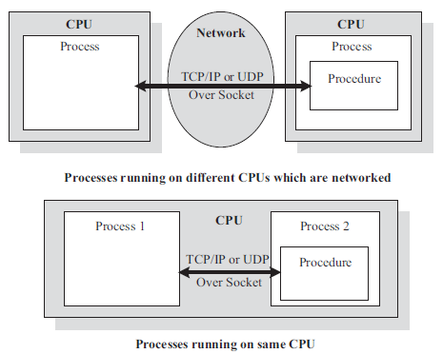
TASK COMMUNICATION
Remote Procedural Call (RPC)
Sockets are used for RPC communication. Socket is a logical endpoint in a two-way communication link between two applications running on a network. A port number is associated with a socket so that the network layer of the communication channel can deliver the data to the designated application. Sockets are of different types, namely, Internet sockets (INET), UNIX sockets, etc. The INET socket works on internet communication protocol. TCP/IP, UDP, etc. are the communication protocols used by INET sockets.

Slide 64
TASK COMMUNICATION
Remote Procedural Call (RPC)
sockets are classified into:
Stream sockets
Stream sockets are connection oriented and they use TCP to establish a reliable connection.
Datagram sockets
Datagram sockets rely on UDP for establishing a connection.
The UDP connection is unreliable when compared to TCP. The client-server communication model uses a socket at the client side and a socket at the server side.
A port number is assigned to both of these sockets.

Slide 65
TASK SYNCHRONIZATION
The act of making processes aware of the access of shared resources by each process to avoid conflicts is known as ‘Task/ Process Synchronization’.
Various synchronization issues may arise in a multitasking environment if processes are not synchronized properly. Few of them are:
Task Communication/Synchronization issues
Racing
Dead Locks
Task Synchronization Techniques
MUTEX (Mutual Exclusion)
Semaphores.

Slide 66
How to chose RTOS:
A lot of factors need to be analyzed carefully before making a decision on the selection of an RTOS.
These factors can be either
Functional requirements
Non-functional requirements
Functional requirements:
1. Processor support
2. Memory Requirements
3. Kernel and Interrupt Latency
4. Inter process Communication (IPC) and Task Synchronization
5. Modularization Support
6. Development Language Support

Slide 67
Non-functional requirements
1. Custom Developed or Off the Shelf
2. Cost
3. Development and Debugging tools Availability
4. Ease of Use
5. After Sales

Slide 68
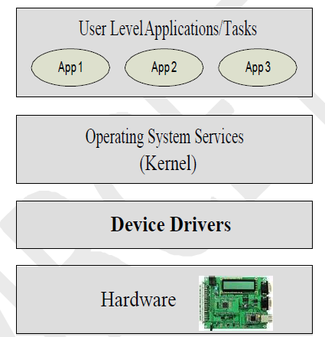
Device Drivers: Device driver is a piece of software that acts as a bridge between the operating system and the hardware

Slide 69
Hardware –Software Co-design
Fundamental Issues in Hardware Software Co-Design:
1.Selecting the model
2.Selecting the architecture
3.Selecting the language
4.Partitioning System Requirements into Software and Hardware

Slide 70
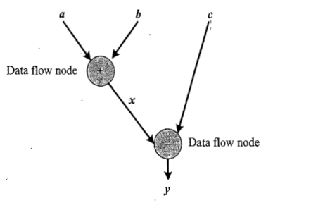
Computational models in embedded design
1.Data Flow Graph model:

Slide 71
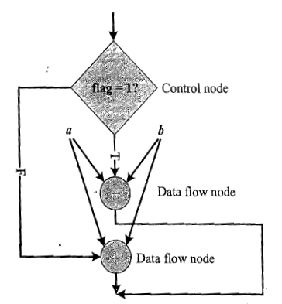
Computational models in embedded design
2.Control Data Flow Graph

Slide 72
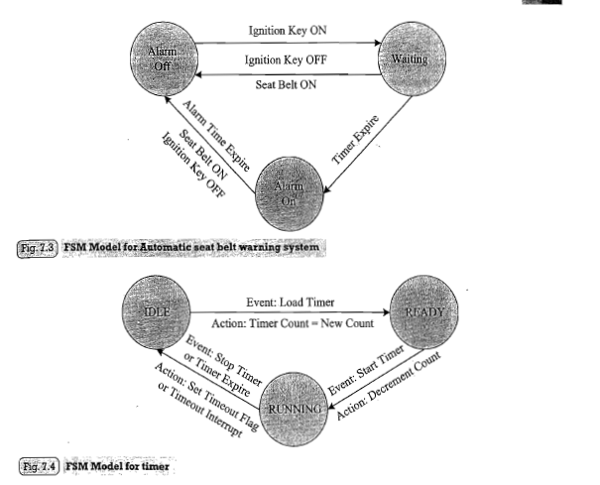
Computational models in embedded design
3.State Machine Model

Slide 73
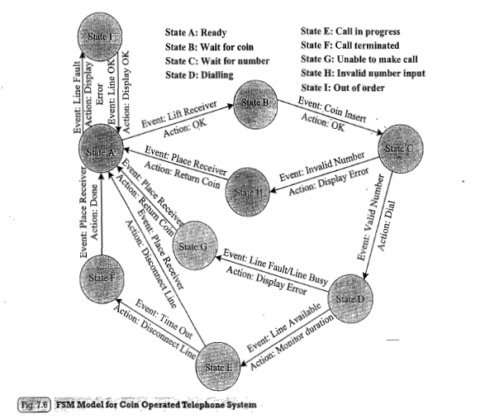
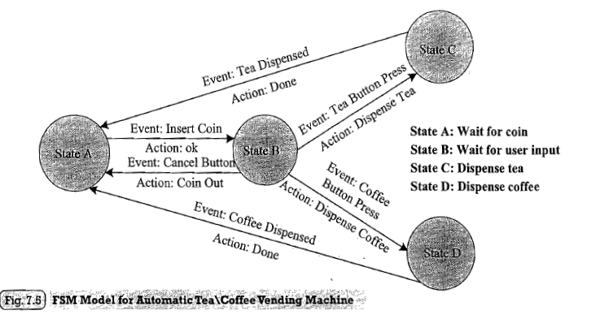
Computational models in embedded design 3.State Machine Model

Slide 74
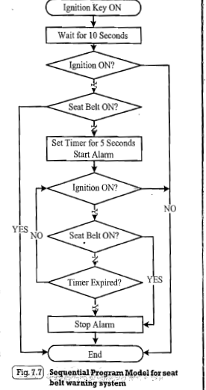
Computational models in embedded design
4.Sequential Program Model
5.Concurrent/Communicating Process model

Slide 75
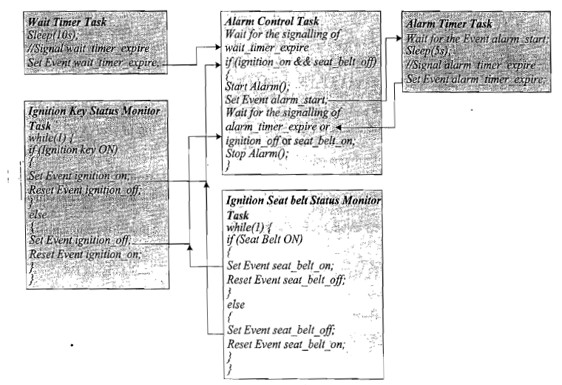
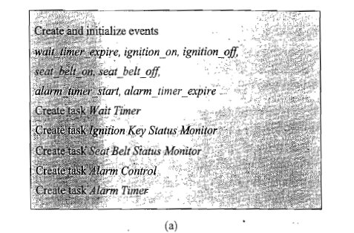
Computational models in embedded design-6.Object Oriented Model

Slide 76
Hardware-Software Trade -off
Performance
Reconfigurability
Cost
Human efforts
Reliability
Memory Size

Slide 77
Assignment
Integration of Hardware and Firmware
ICE

